Slide 1
Predicting High Cost Claims Using ML
PRESENTED BY
GLOBAL ANALYTICS
Ashwani Verma
Sarun Bhatta
Uyaruun Purevdorj

Slide 2

Project Goal
The main goal of our project is to predict which claims will be flagged as High Dollar Claims.

Slide 3

Project Overview
1
Data Exploration and EDA
2
Data Preprocessing
3
Feature Engineering
4
Model Selection and Training
5
Model Evaluation
6
Conclusion

Slide 4

Data Exploration and EDA
We first explored the data using data visualization techniques. We used different visualization charts like Barplots, Boxplots, Histogram, Heatmaps, etc., in order to have a better understanding of the data and interpret the data.

Slide 5
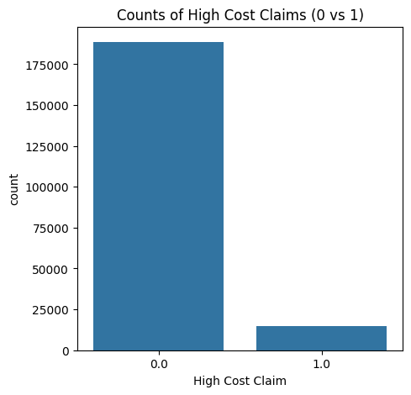

Barplots
We used Bar plots to see different distributions like High Cost Claims,
Gender Distributions etc.
Here in the chart we can see most of the claims are low cost claims.

Slide 6
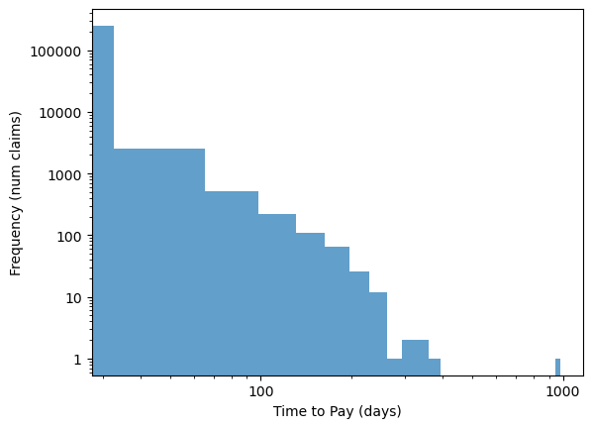
Histogram
Used Histogram to see the Time to Pay i.e. difference between Paid Date and Received Date columns.
We can see that most of the claims were paid on the 7th day after the received date, while an outlier took ~1000 days.

Slide 7
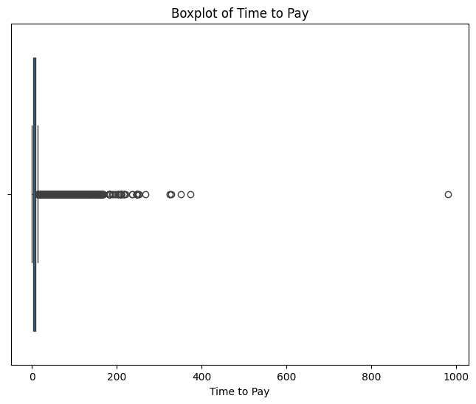
Boxplot

Slide 8
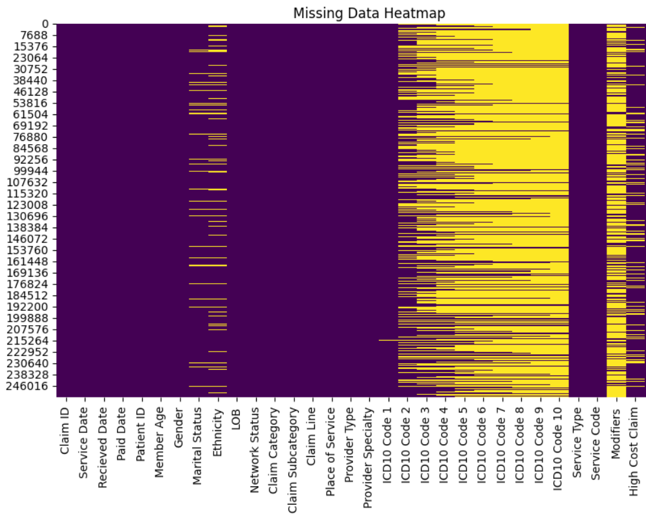
Heatmaps
Yellow color signifies the missing data.
Our main goal in this project is to predict the yellow ones in the High-Cost Claim.

Slide 9
Data Preprocessing
  Ensuring No Patient Appears in Both Train & Test Sets.
This prevents data leakage(data contamination) and makes the model more reliable.
Steps:
  Drop duplicates to get unique patients only.
  Split these unique patients either in train (80%) or test (20%).
  Finally, assign all claims for each patient to the same dataset.

Slide 10
Feature Engineering
  We used sparse features, which only store non-zero values, to reduce runtime and memory usage.
  Service Date, Received Date, and Paid Date were excluded, as they did not improve model performance.
  Claim ID and Patient ID were dropped because they were unique identifiers and not helpful for model improvement.
  Our approach was to de-normalize the dataset, creating independent features that the model could correlate with high-cost claims. We'll explain how we applied this technique to the classes and labels.

Slide 11
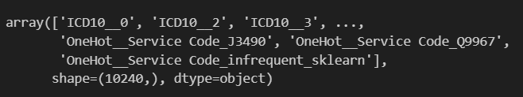
Feature Engineering & Transformation
  Converted categorical data into 10,240 numerical features which includes ICD-10 Codes, Service Codes and Patient Demographics.
  This transformation allowed our model to extract meaningful patterns from the data.

Slide 12
Classes
  Features like Age and Gender were treated as classes, meaning each feature had distinct categories.
  These categories were one-hot encoded, which involved creating a separate column for each category.
  Categories with very few occurrences were removed to help avoid overfitting on these data.
Input
Output
Id | Age
1 | < 1 Yrs Old
2 | 30-39 Yrs Old
3 | 10-19 Yrs Old
Id | < 1 Yrs Old | 1-9 Yrs Old | 10-19 Yrs Old | 20-29 Yrs Old | 30-39 Yrs Old | ...
1 | 1
2 |  |  |  |  | 1
3 |  |  | 1

Slide 13
Labels
  ICD10 codes and Modifiers were treated as labels, meaning they could belong to multiple categories at once.
  These were multi-hot encoded, where each unique code or modifier was mapped to its own column.
  As with the classes, categories with low frequency were dropped to prevent overfitting on these data.
Input
Output
Id | Modifiers
1 | AK
2 | F3,3M
3
Id | AK | B3 | CB | F3 | 3M | ...
1 | 1
2 |  |  |  | 1 | 1
3

Slide 14
Model Selection
Linear Support Vector Classifier (LinearSVC)
  Chosen for its efficiency in handling high-dimensional & imbalanced datasets.
  Finds an optimal hyperplane to separate high-cost vs. low-cost claims.
Handling Class Imbalance
1.High-cost claims are much fewer than regular claims.
2.Used class_weight='balanced' to assign more weight to minority class.

Slide 15
Hyperparameter Optimization (GridSearchCV)
Best Parameters: C = 0.005
Loss Function: squared_hinge

Slide 16
Model Performance
Cross Validation F1-score: 75.8% on validation data
  Balances Precision and Recall
  distinguishes between high-cost and low-cost claims while minimizing FP and FNs.

Slide 17

Model Evaluation – Test Performance
  Balances precision & recall, ensuring correct identification of high-cost claims.
  F1-score is crucial for imbalanced datasets.
  Balanced accuracy ensures fair classification across all claim types.

Slide 18
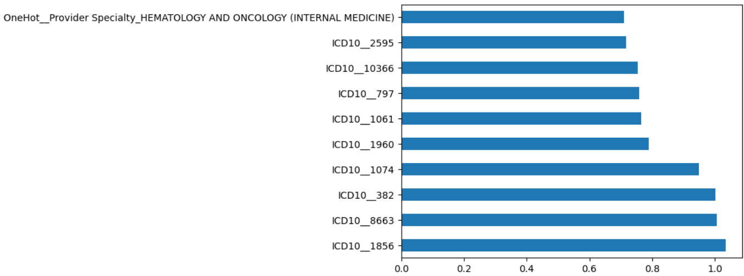
Positive Coefficients:
Features that may increase the probability of a high-cost claim.

Slide 19
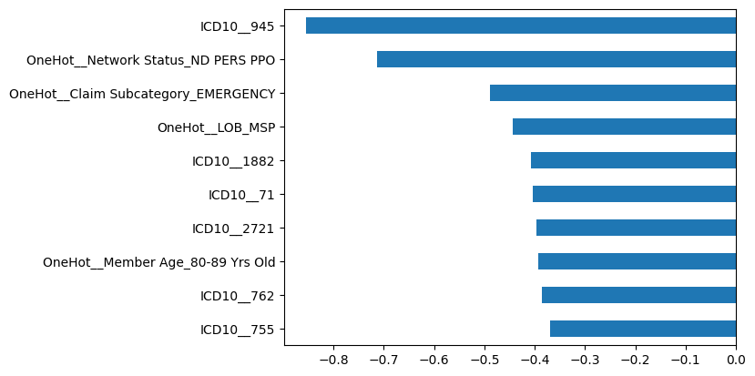
Negative Coefficients:
Features that may decrease the probability of a high-cost claim.

Slide 20
Conclusion
  Successfully built a predictive model to classify high-cost claims.
  Feature importance analysis highlighted key ICD-10 codes, service codes, and patient demographics affecting claim costs.

